Slide 1
RLC circuits

Slide 2
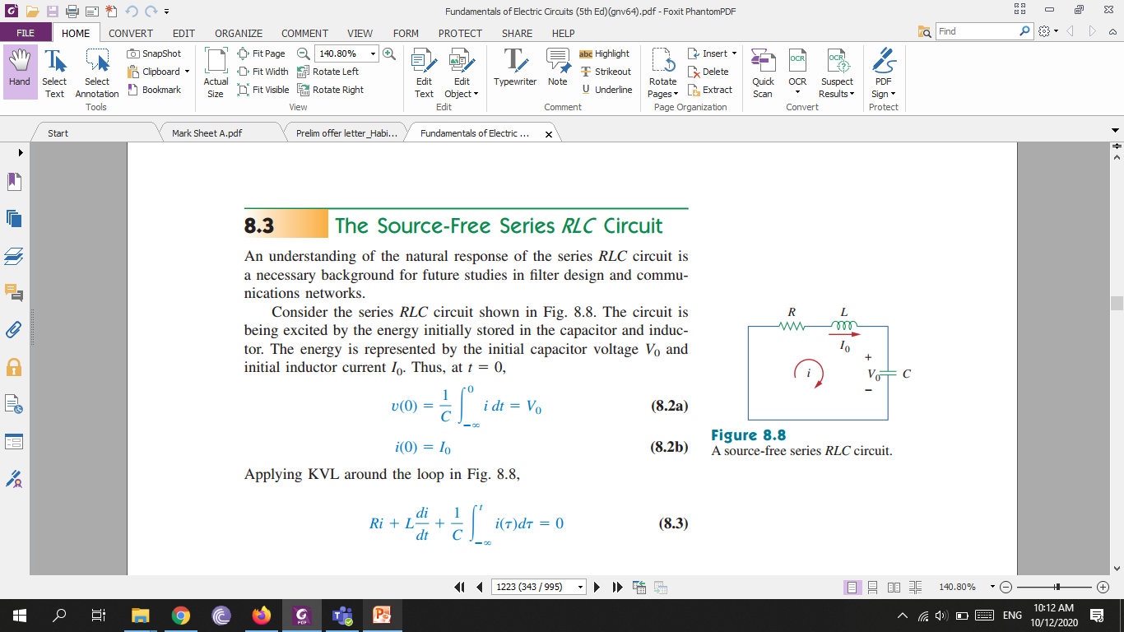

The Source-Free Series RLC Circuit
Circuit is initially excited. At t=0

Slide 3
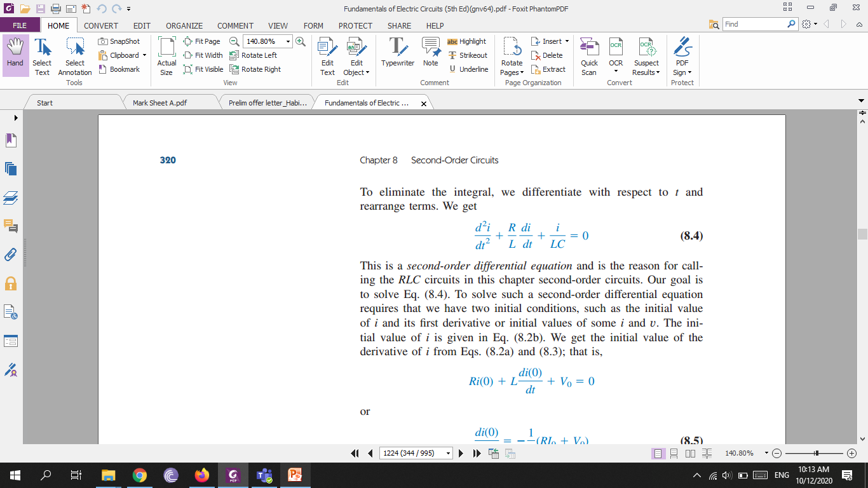
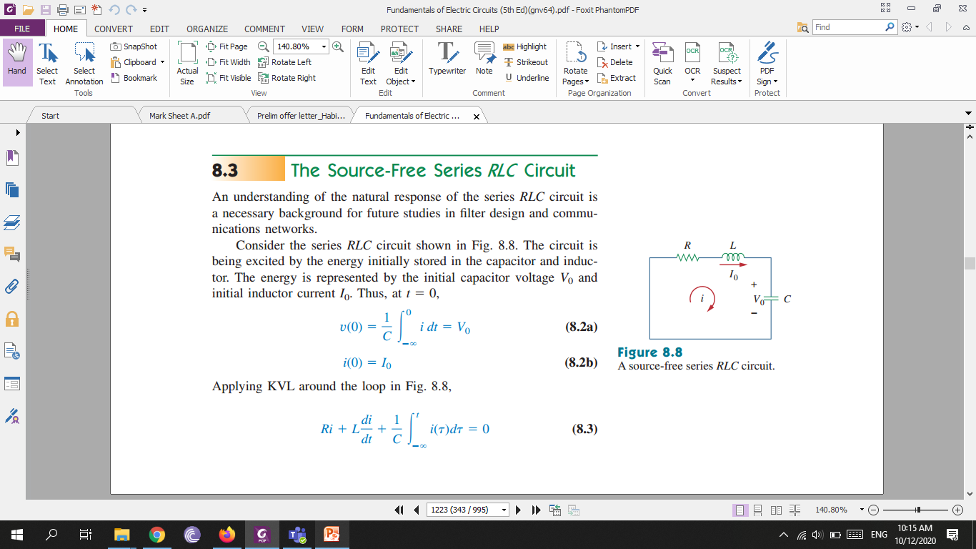
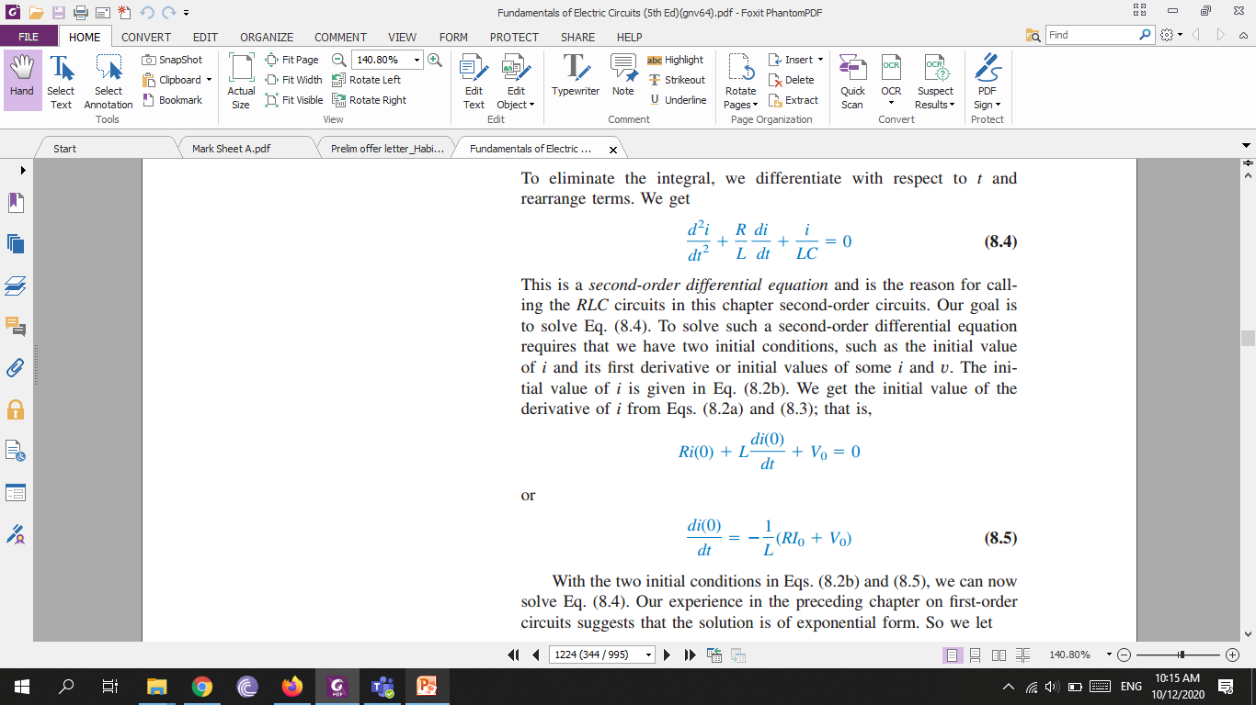
To eliminate the integral, we differentiate with respect to t and rearrange terms. We get
This is a second-order differential equation and is the reason for calling the RLC circuits in this chapter second-order circuits. To solve such a second-order differential equation requires that we have two initial conditions, such as the initial value of i and its first derivative or initial values of some i and v.

Slide 4
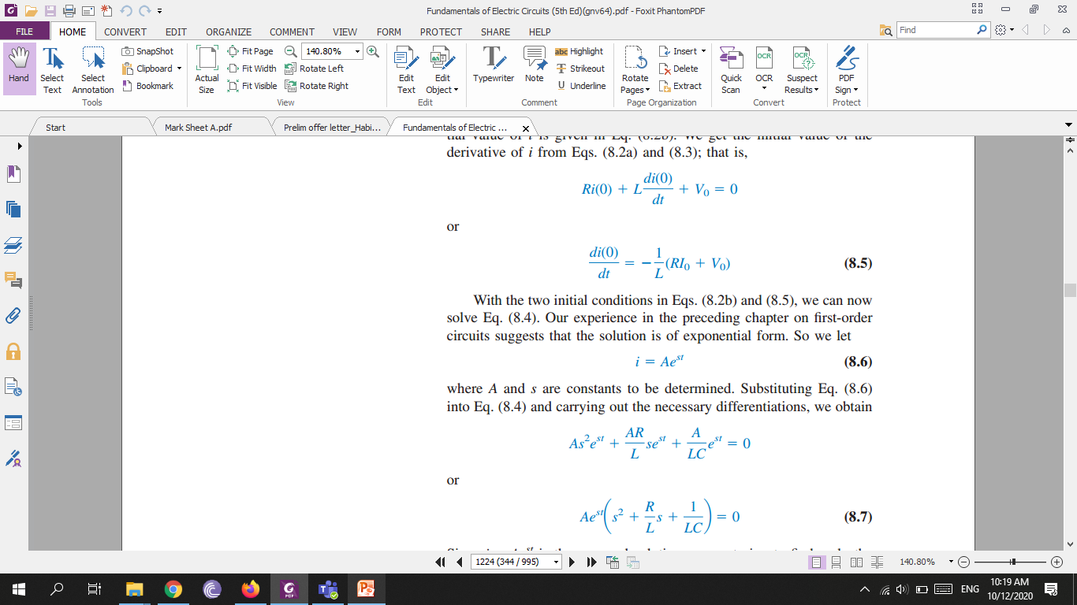
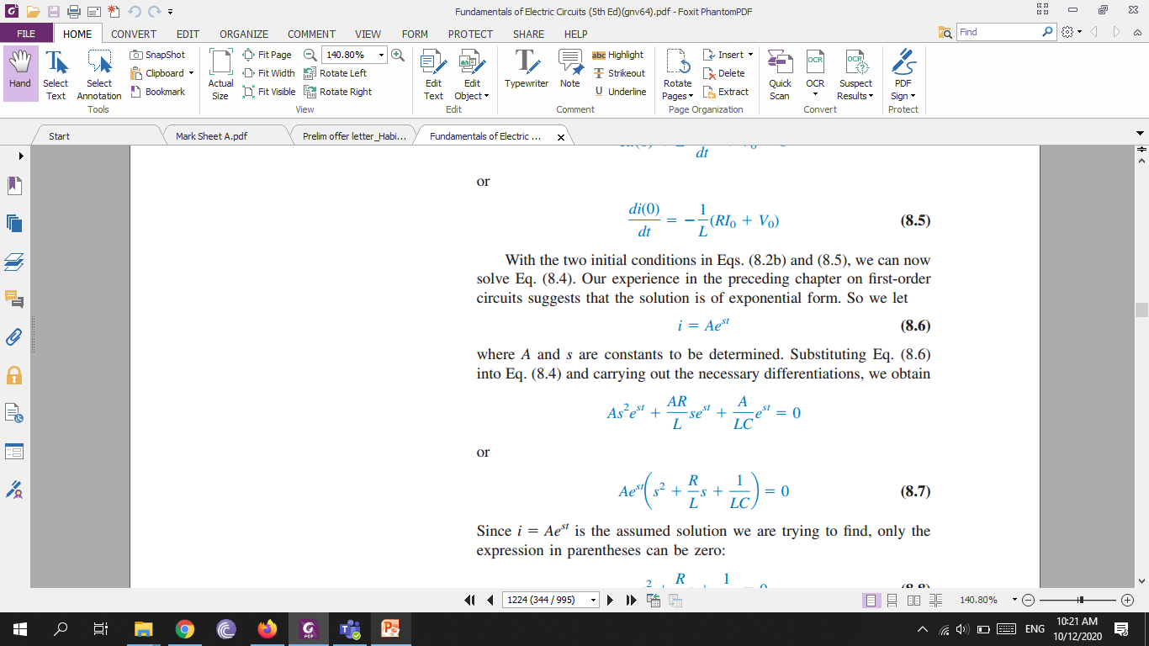
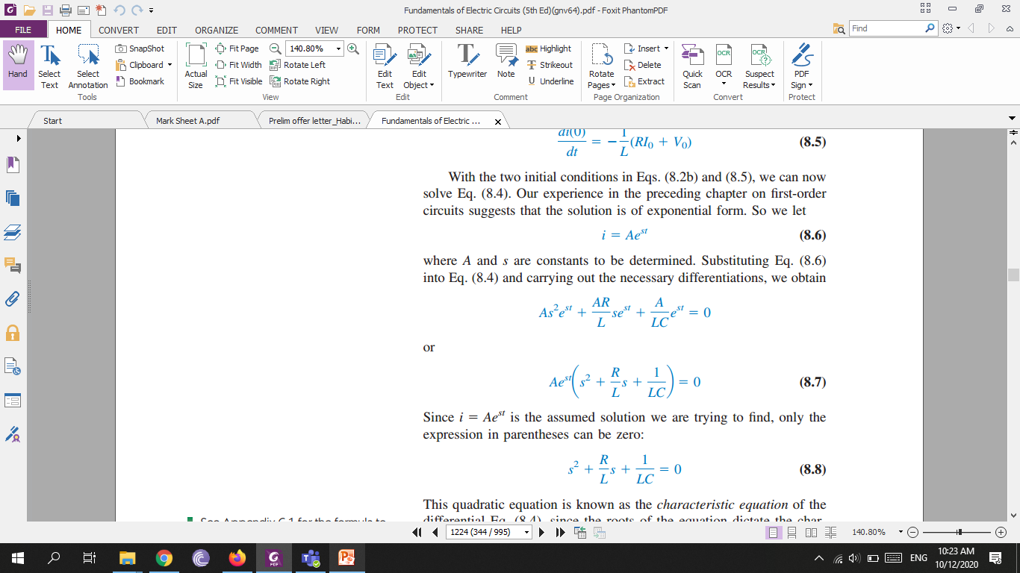
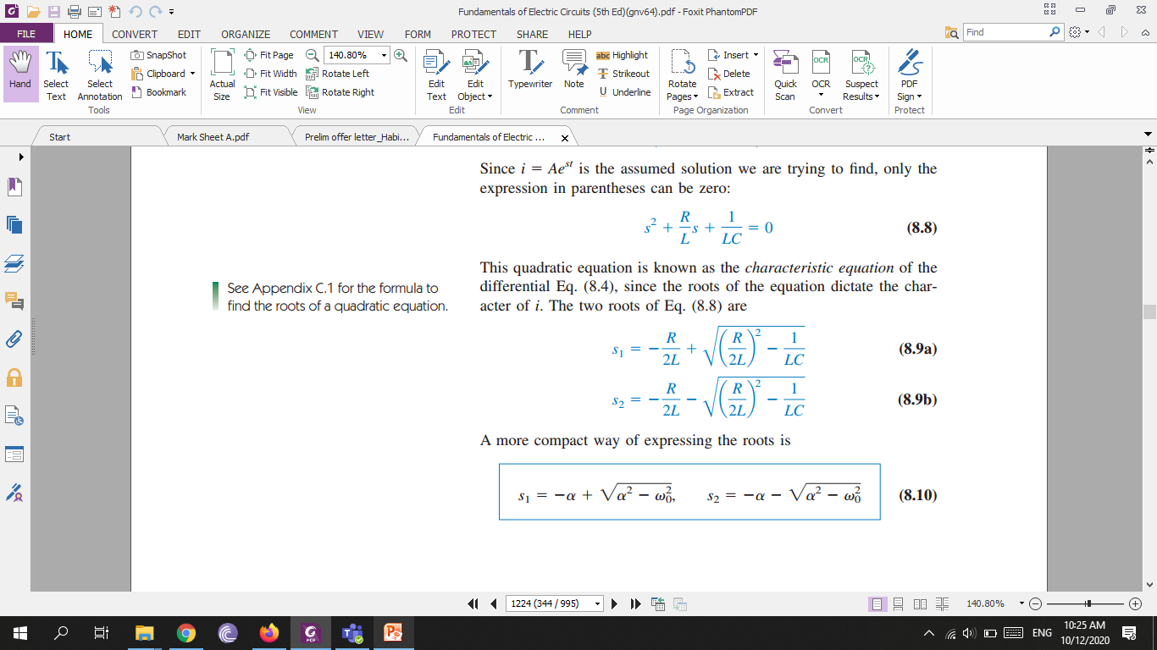
Substituting i in equation 8.4, we will get
This quadratic equation is known as the characteristic equation of the differential Eq. (8.4), since the roots of the equation dictate the character of i. The two roots of Eq. (8.8) are

Slide 5
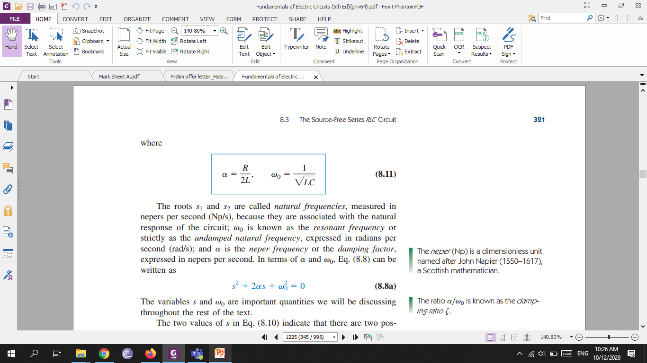
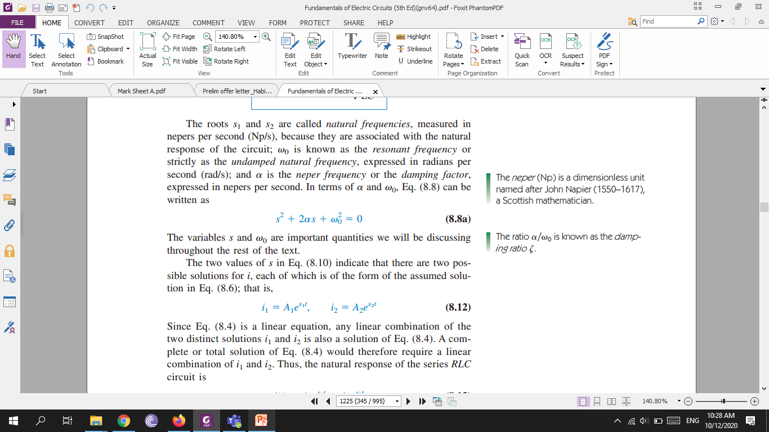

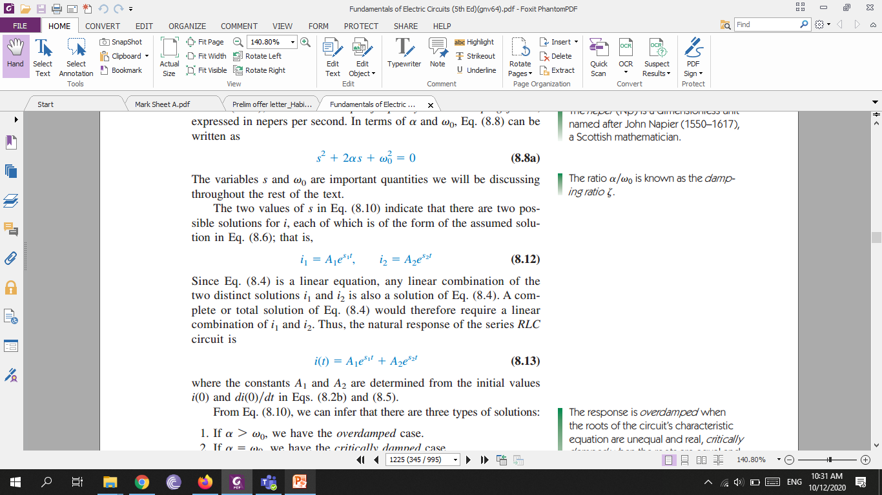
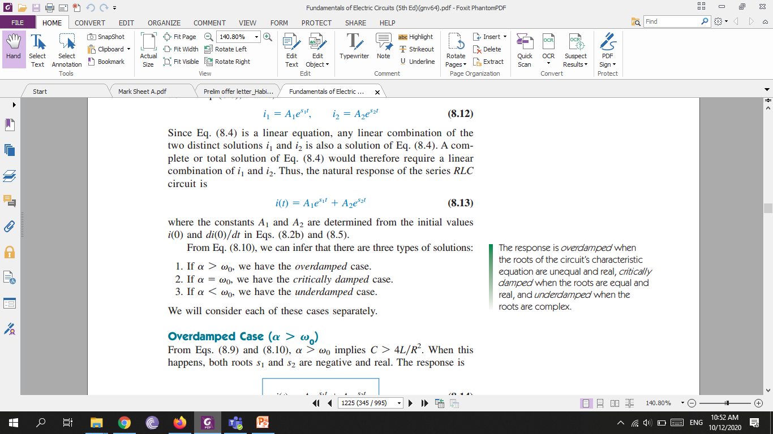
The roots and are called natural frequencies, measured in nepers per second (Np/s), because they are associated with the natural response of the circuit; is known as the resonant frequency or strictly as the undamped natural frequency, expressed in radians per second (rad/s); and is the neper frequency or the damping factor, expressed in nepers per second. In terms of and , Eq. (8.8) can be written as

Slide 6
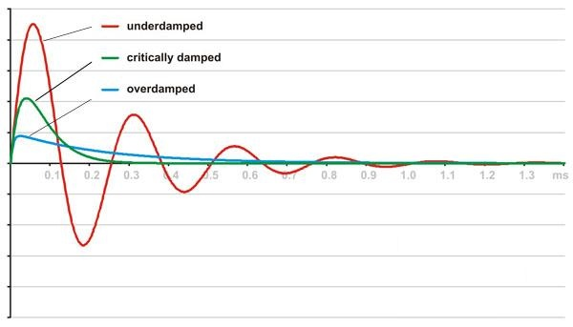

Slide 7
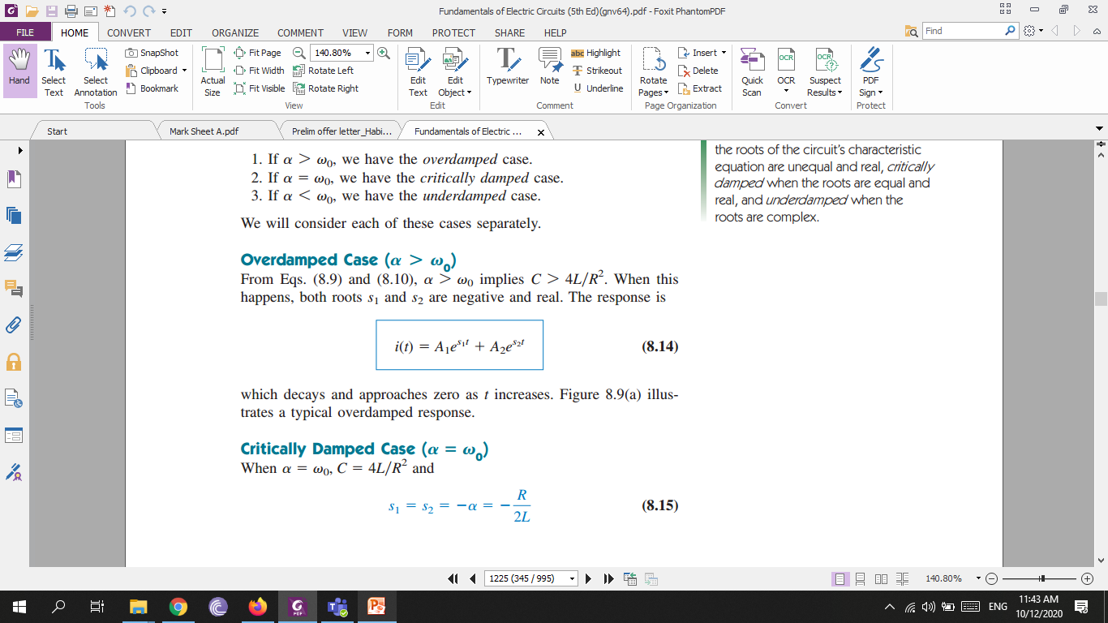
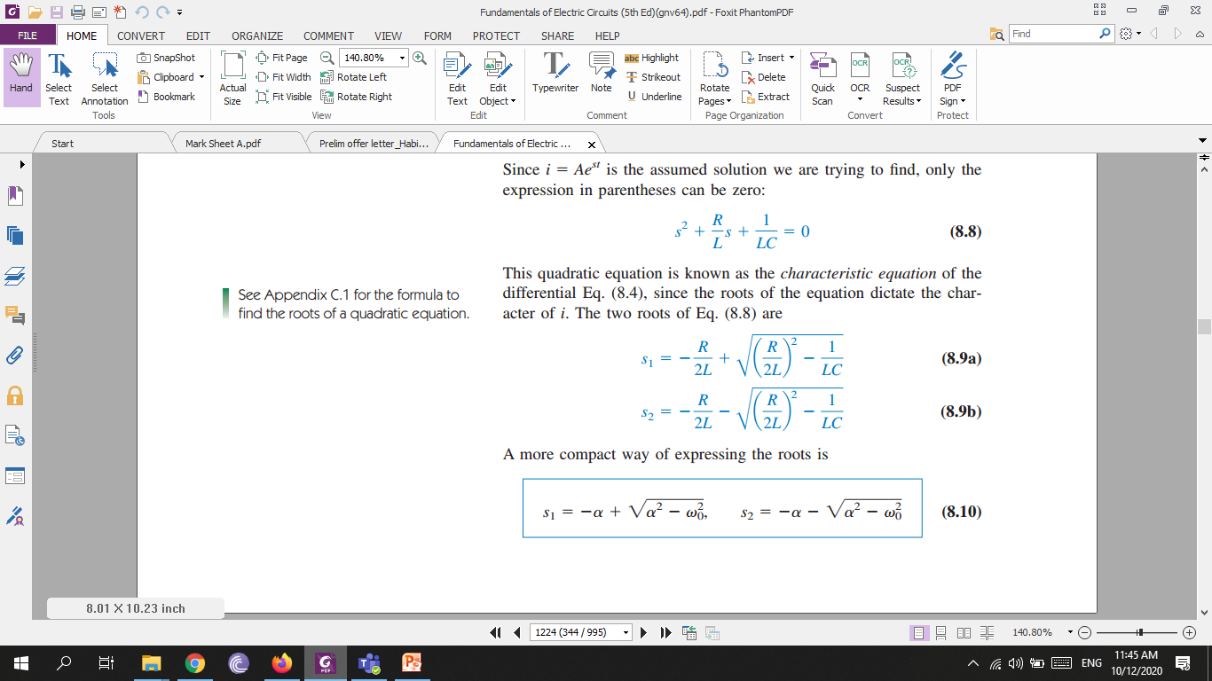
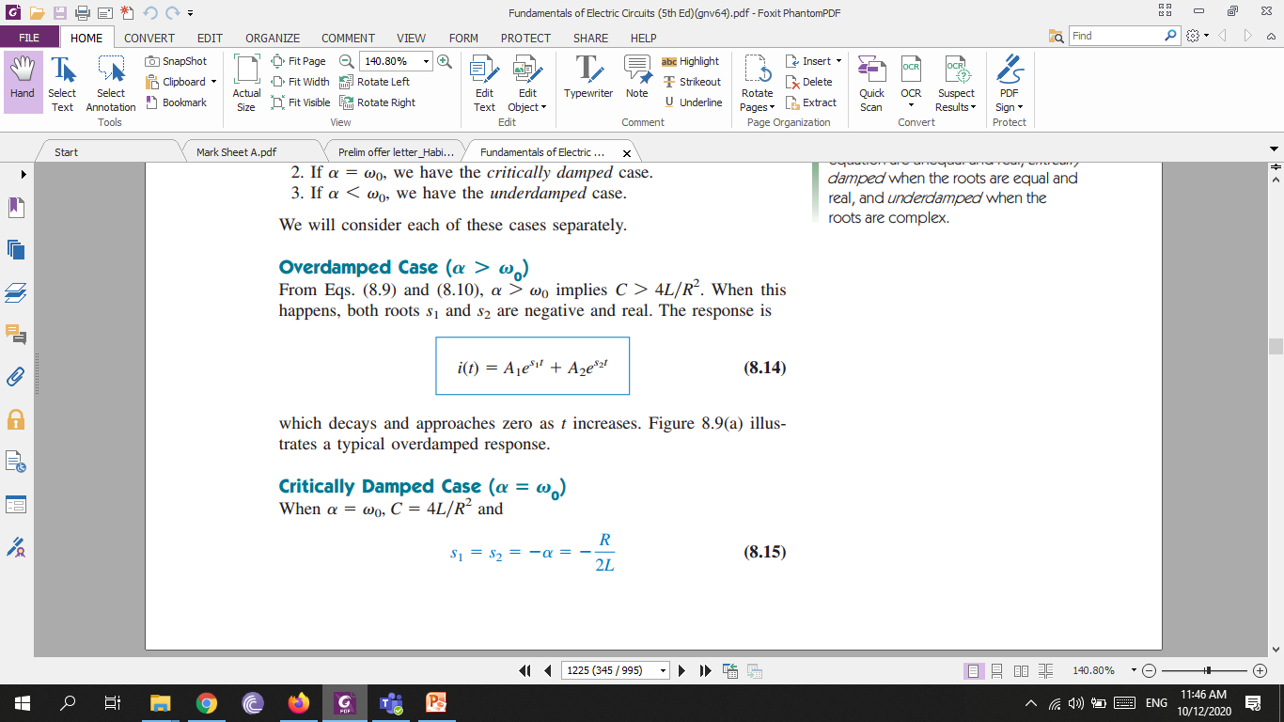
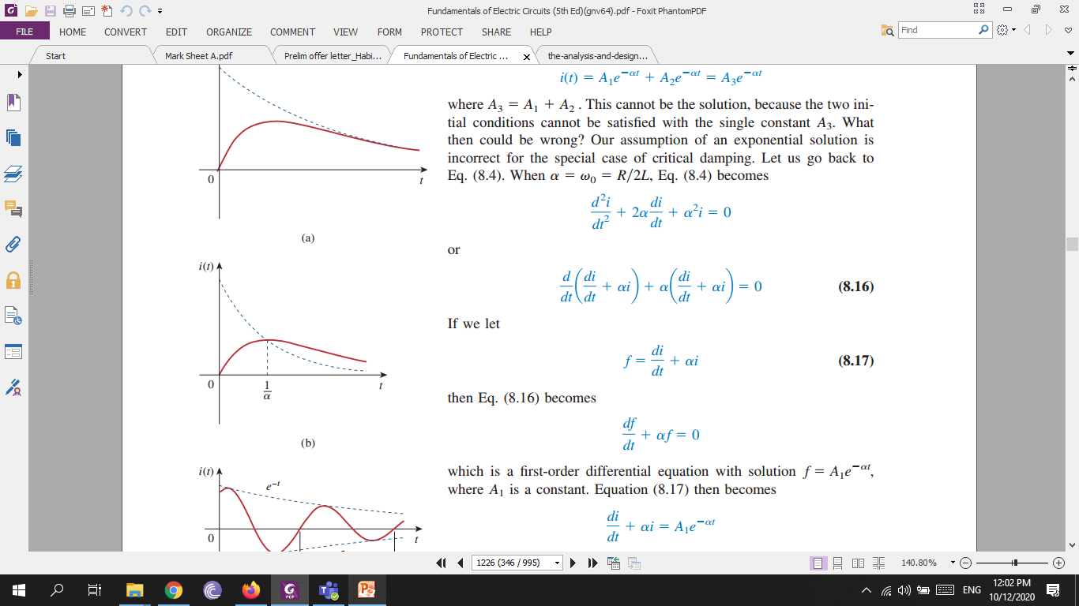
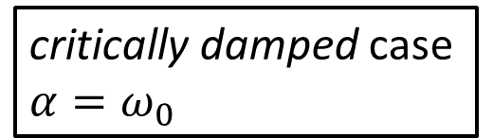
overdamped case
critically damped case $α=ω_{0}$

Slide 8
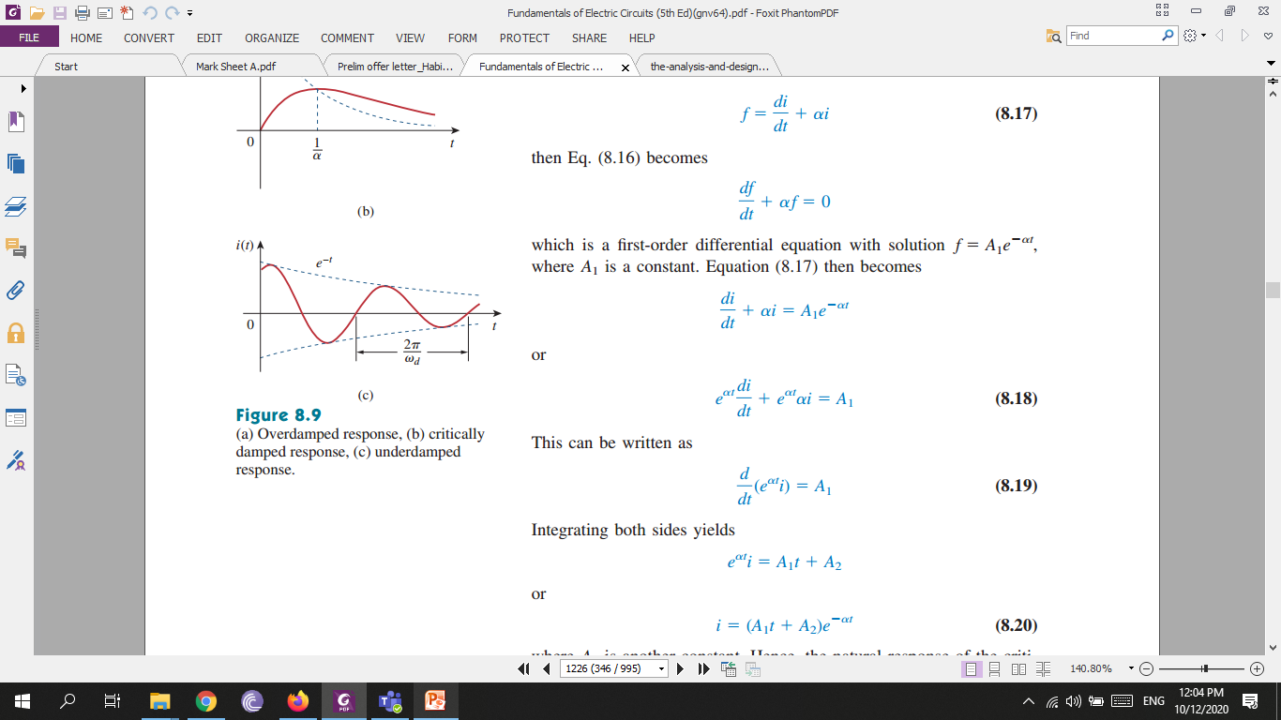

Slide 9
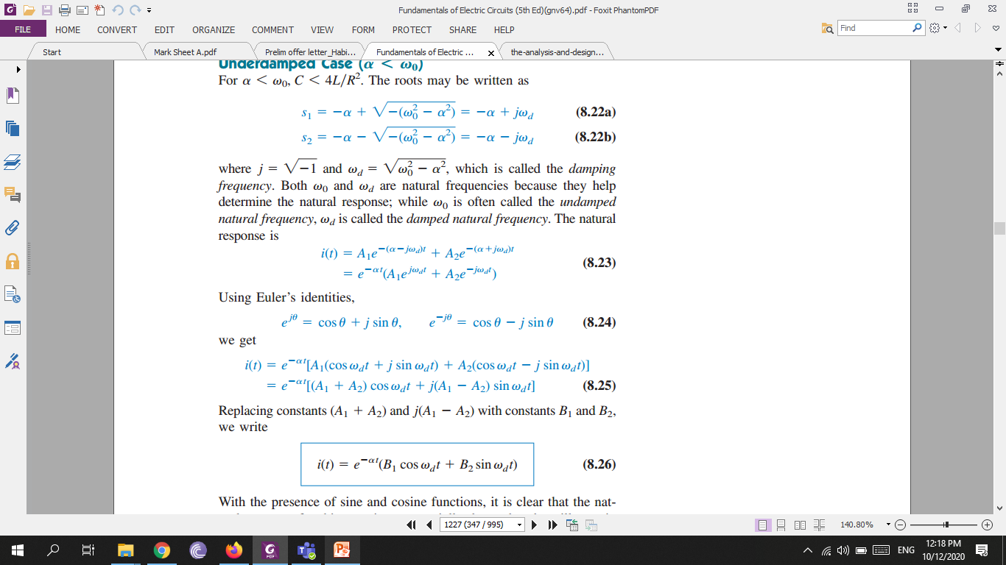
underdamped case

Slide 10
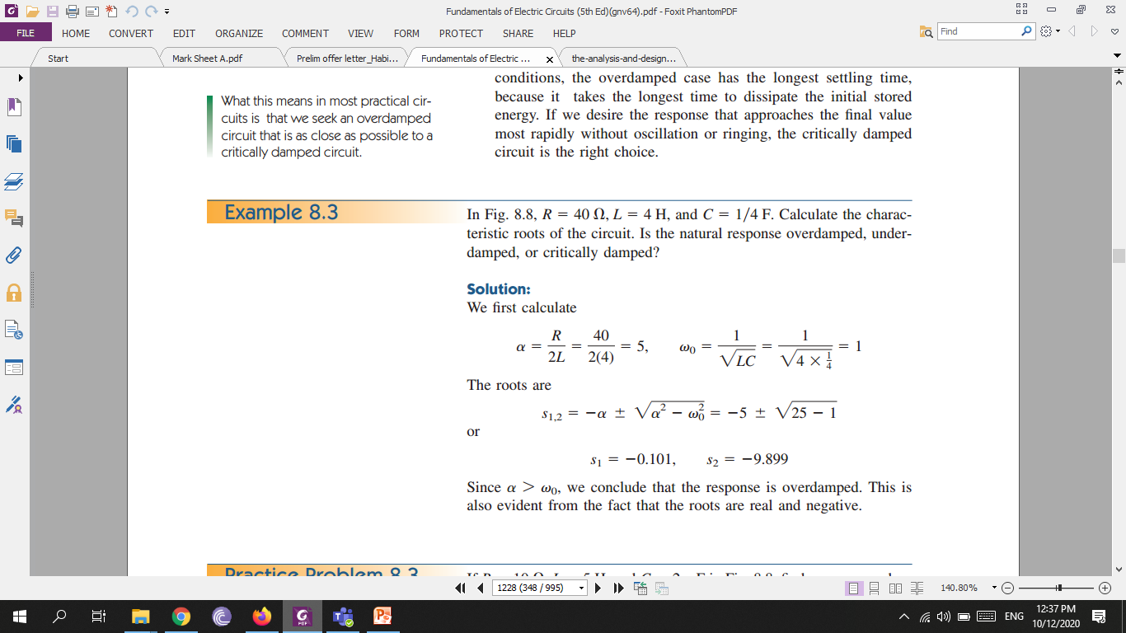

Slide 11
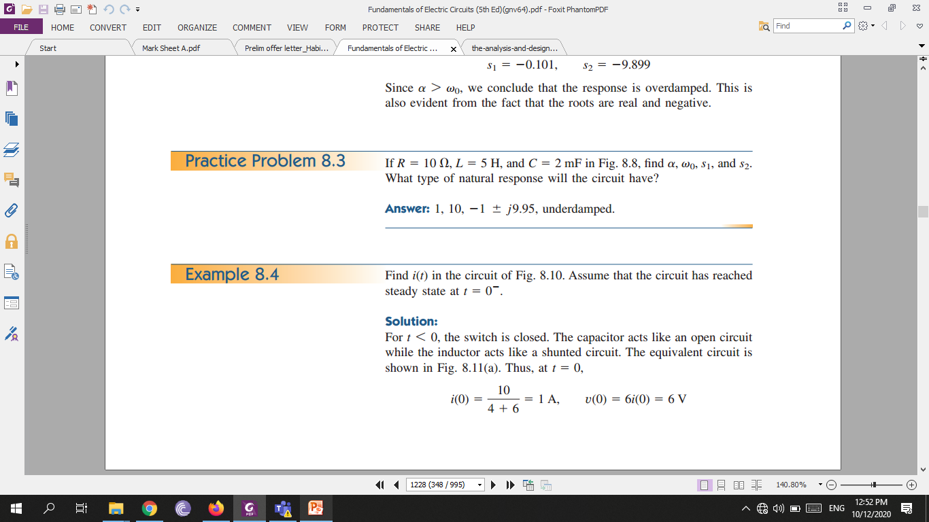
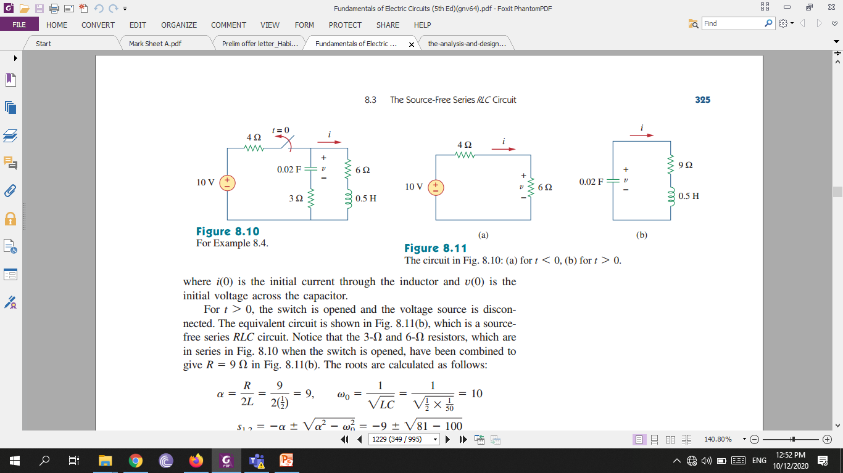

Slide 12
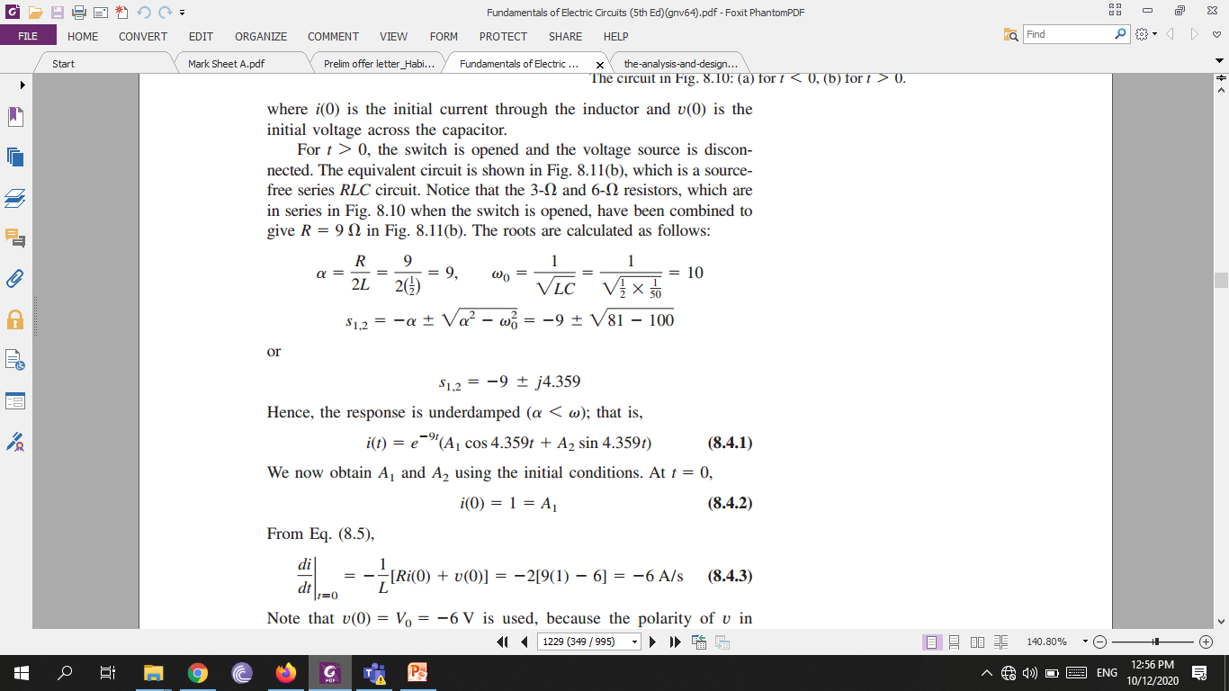
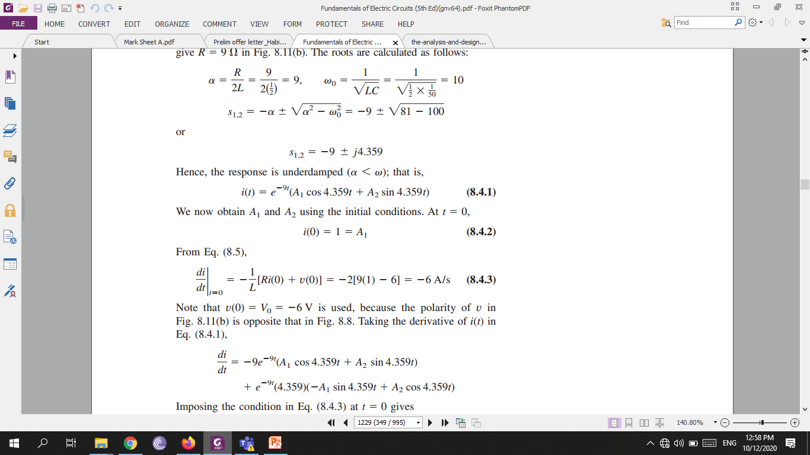

Slide 13
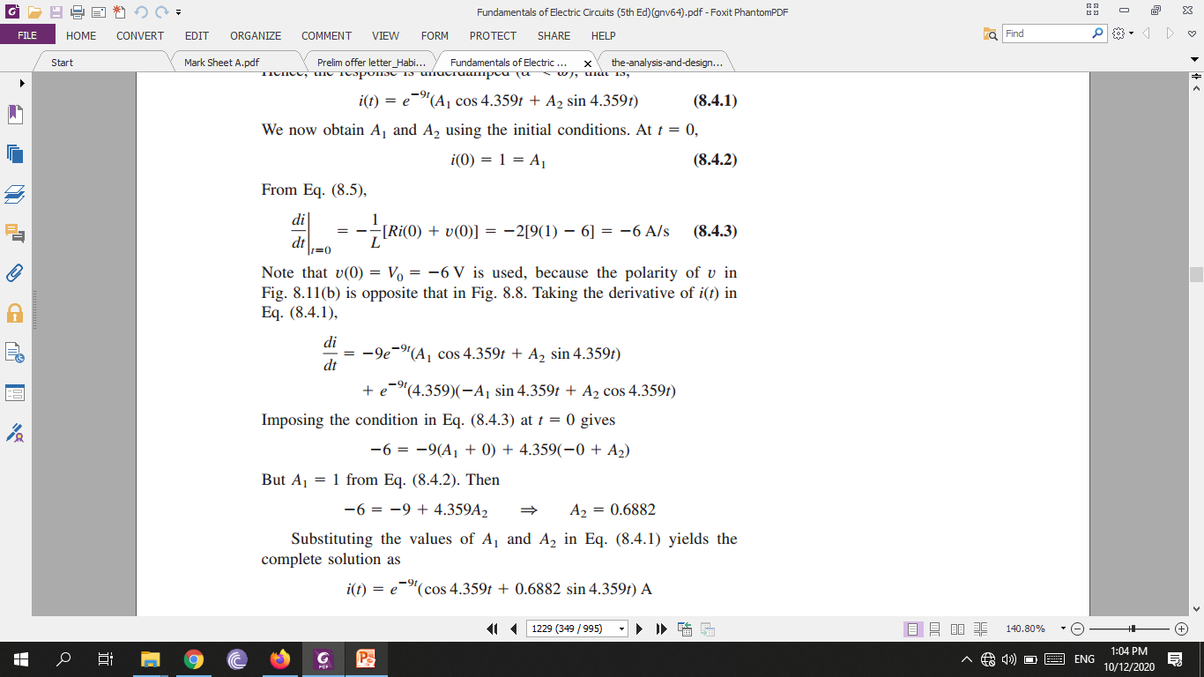

Slide 14
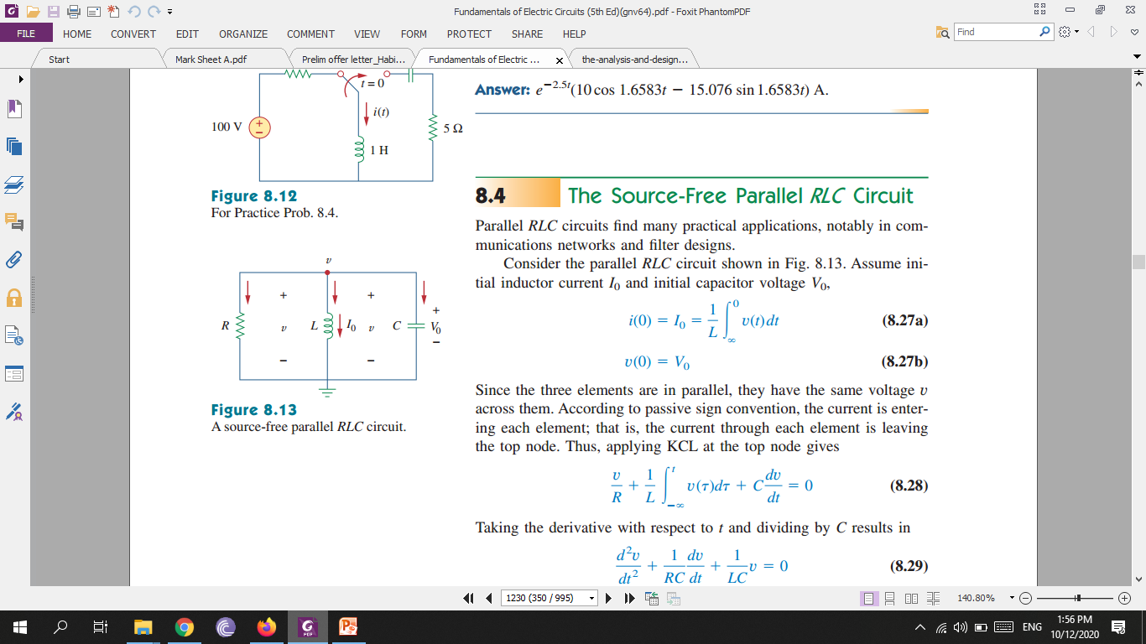
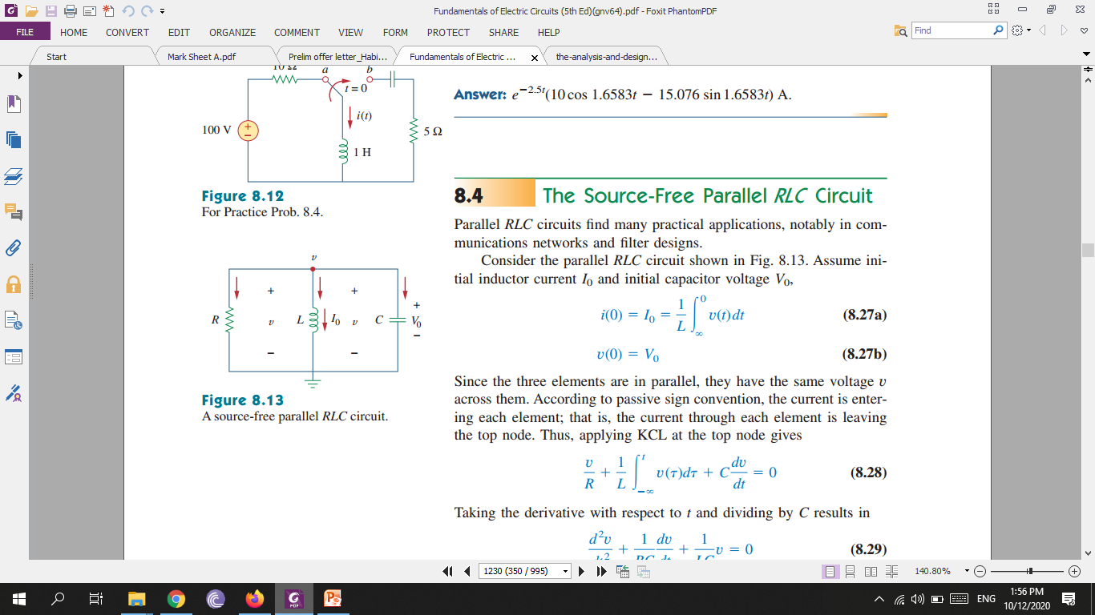
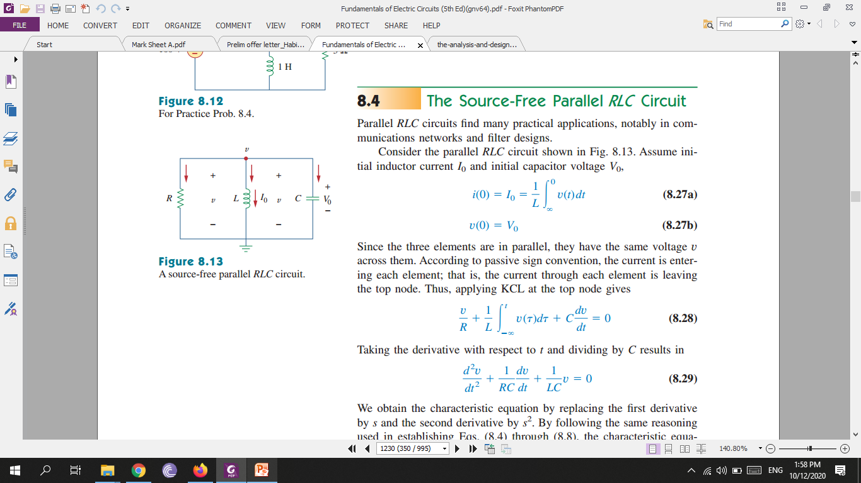

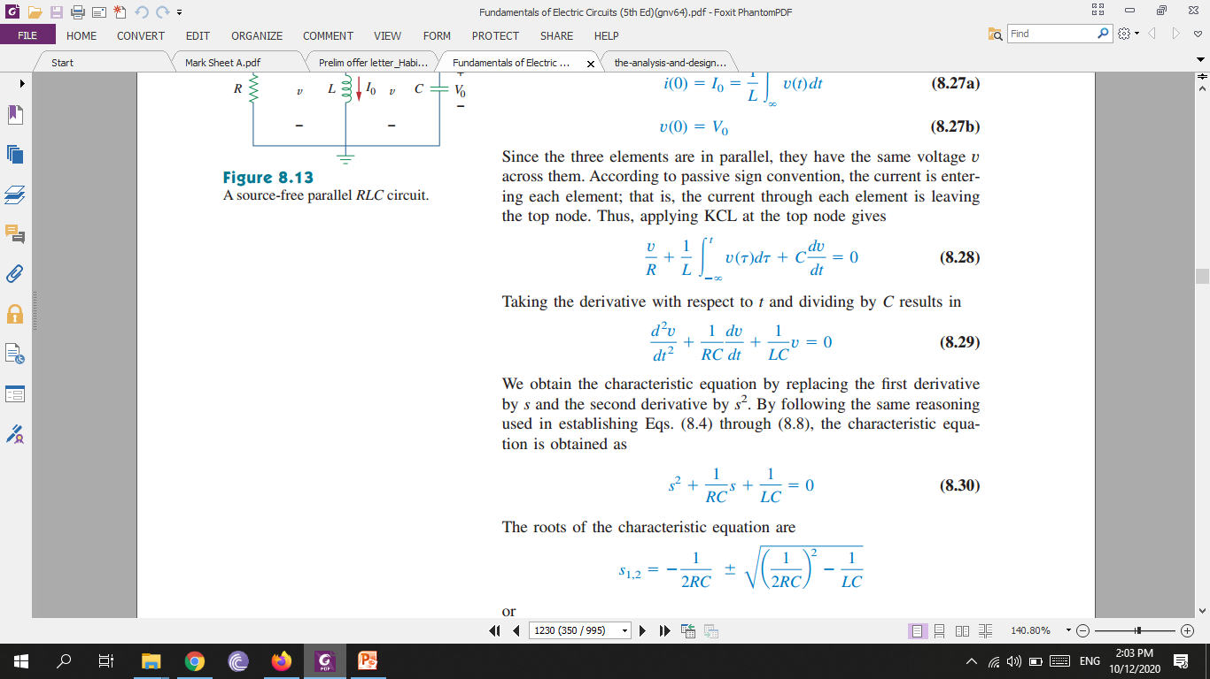
Source-Free Parallel RLC Circuit
We obtain the characteristic equation by replacing the first derivative by $s$ and the second derivative by $s^{2}.$

Slide 15
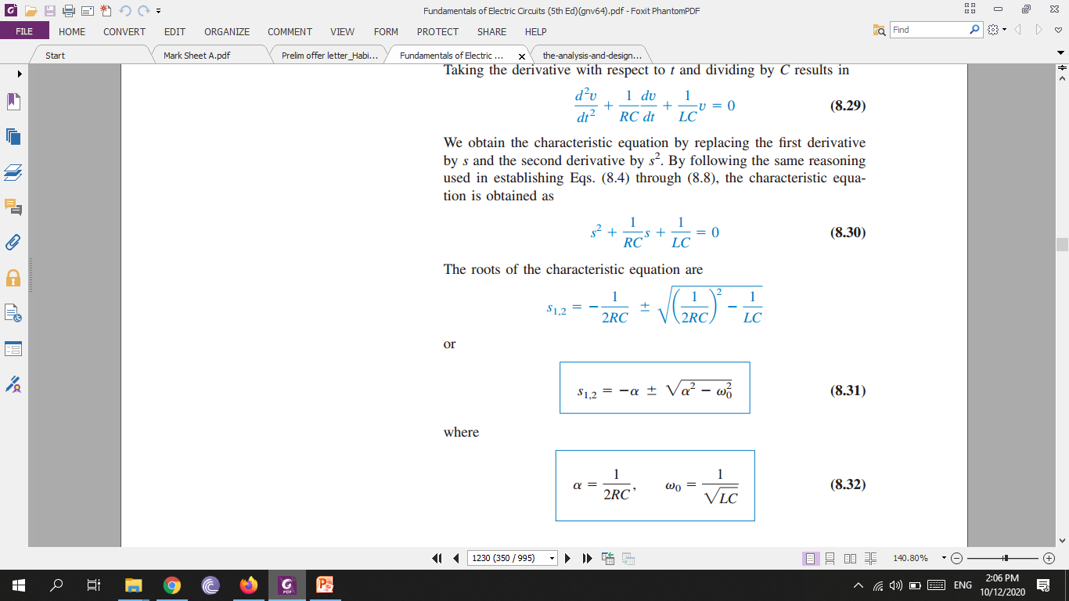

Slide 16
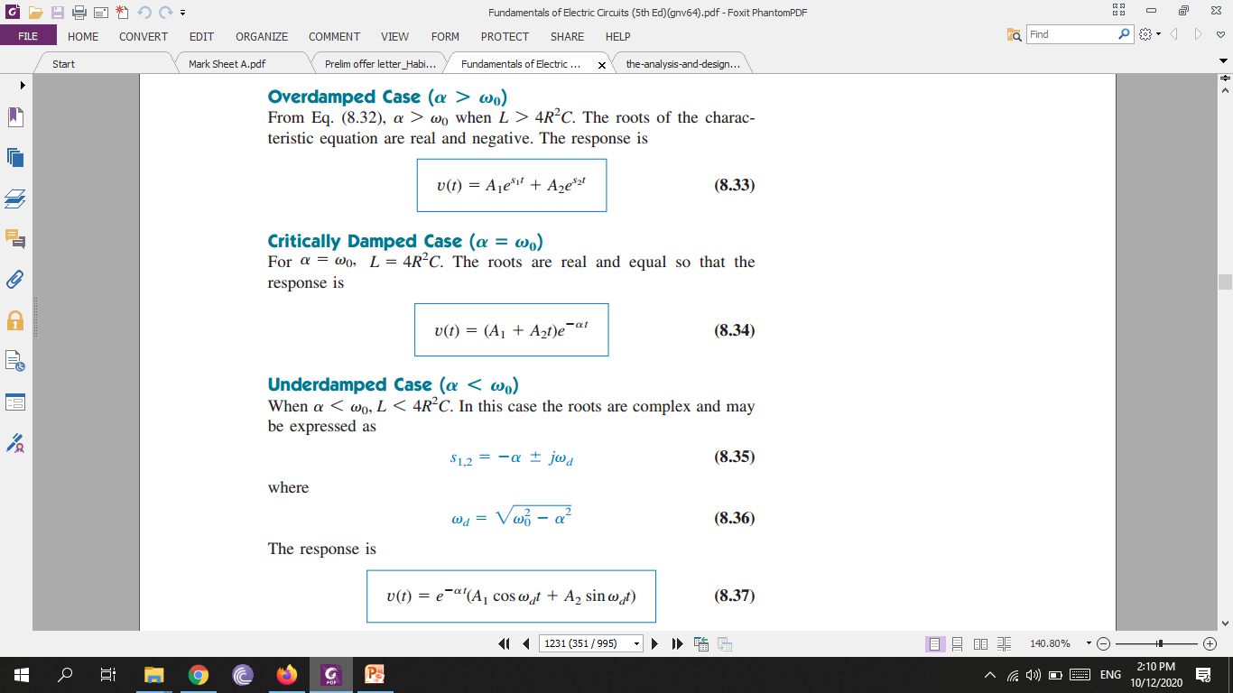

Slide 17
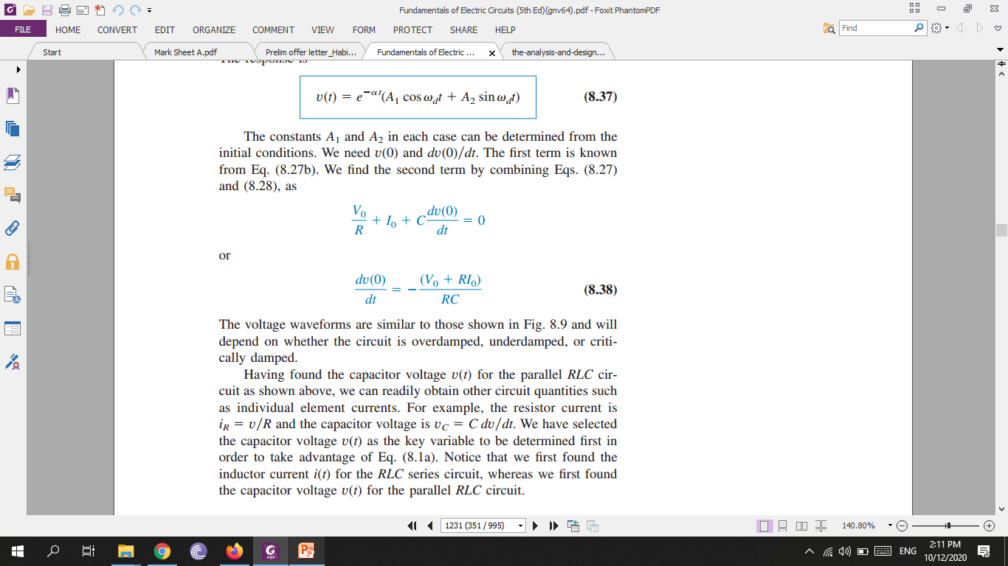
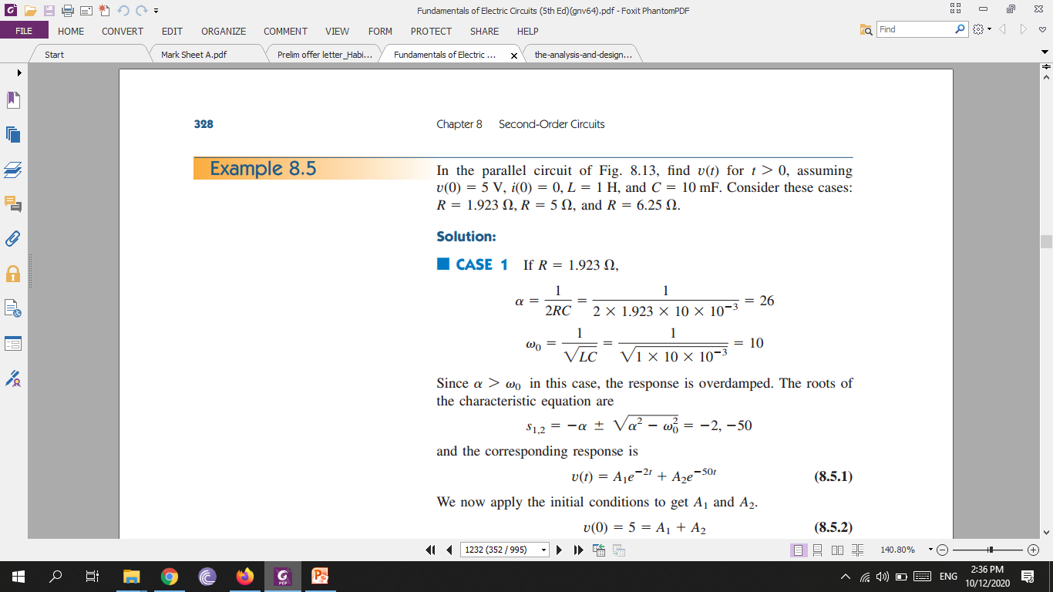
Home work

